Slide 1
LENDING CLUB CASE STUDY SUBMISSION
Name: SHRUTI SHARMA

Slide 2
Business Objective To identify variables which are strong indicators of default and potentially use the insights in approval / rejection decision making.
LENDING CLUB CASE STUDY
Problem statement/Business understanding:
We need to understand the driving factors behind the loan defaulters and non-defaulters. Two types of risks are associated with the bank’s decision:
If the applicant is likely to repay the loan, then not approving the loan results in a loss of business to the company
If the applicant is not likely to repay the loan, i.e. he/she is likely to default, then approving the loan may lead to a financial loss for the company
Understanding the defaulters and non-defaulters can help the company to utilize this knowledge for its portfolio and risk assessment
Data Understanding and goals:
Understanding the data by following a step-by-step approach:
1. Performing exploratory data analysis
2. Targeting the correct variable and
3. Deriving insights and recommendations for low risks and benefit to business

Slide 3
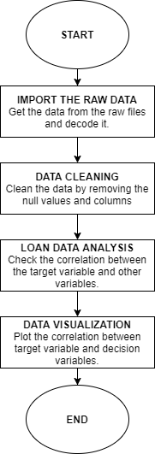
DATA ANALYSIS
Data Preparation
Data Analysis

Slide 4
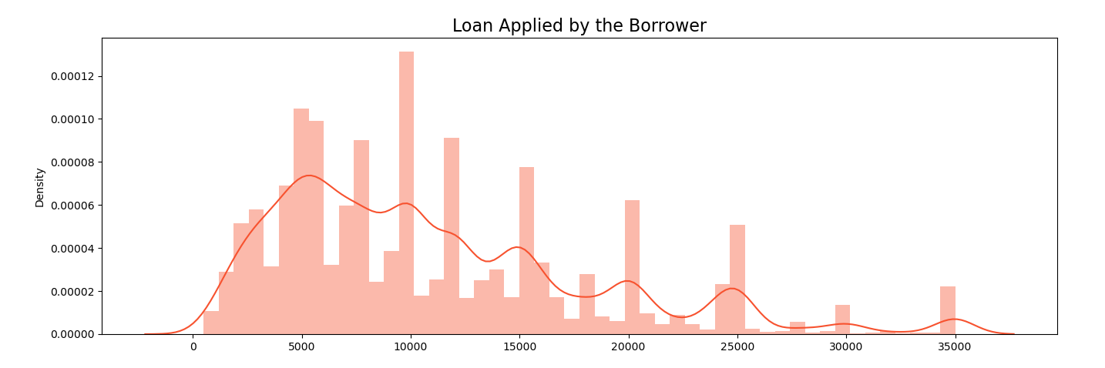
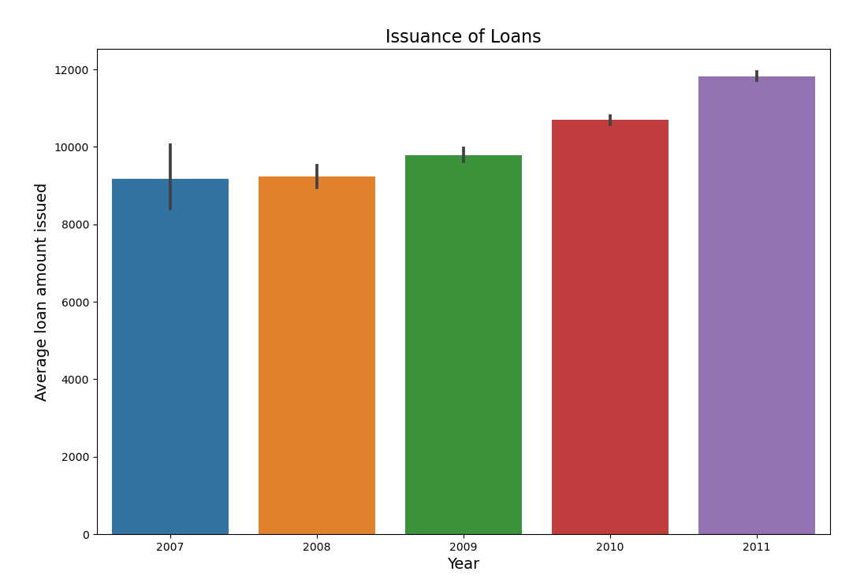
Exploring distribution of Loan amount
Summary:
Most of the loans issued were in the range of 5,000 to 15,000 USD.
The year of 2011 was the year when most loans were issued.
Loans were issued in an incremental manner. (Possible due to a recovery in the U.S economy)
The loans applied by potential borrowers, the amount issued to the borrowers and the amount funded by investors are similarly distributed as per the dataset, which implies that it is most likely that qualified borrowers have high chance of getting the loan they had applied for.

Slide 5
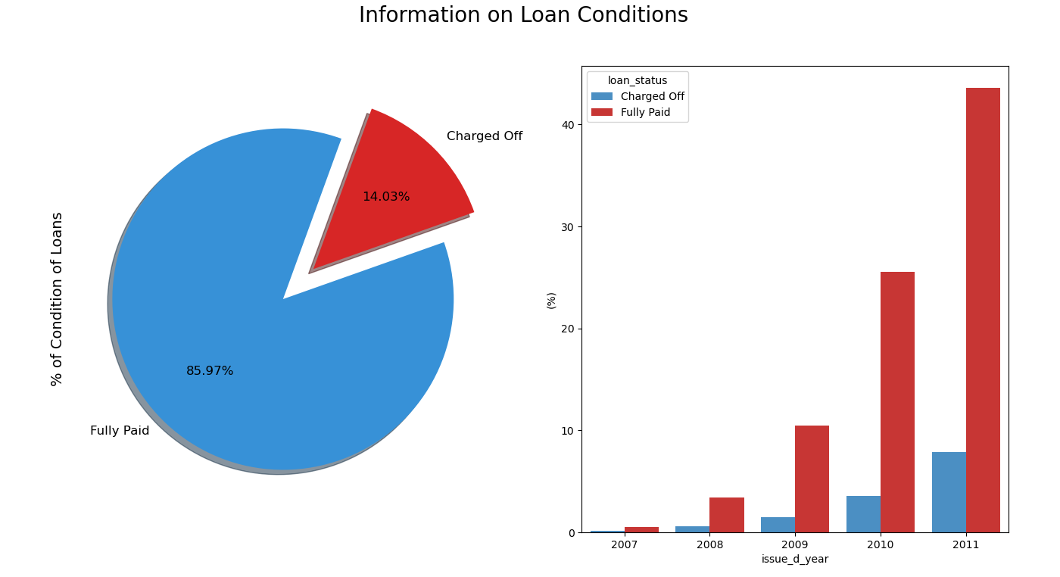
Understanding the loan status
Summary:
Currently, charged off (bad loans) consist 14.03% of total loans but remember we still have current loans which have the risk of becoming bad loans. (So this percentage is subjected to possible changes.)
Approximately 85% of loan have been fully paid (good loans) with most contribution from 2011

Slide 6
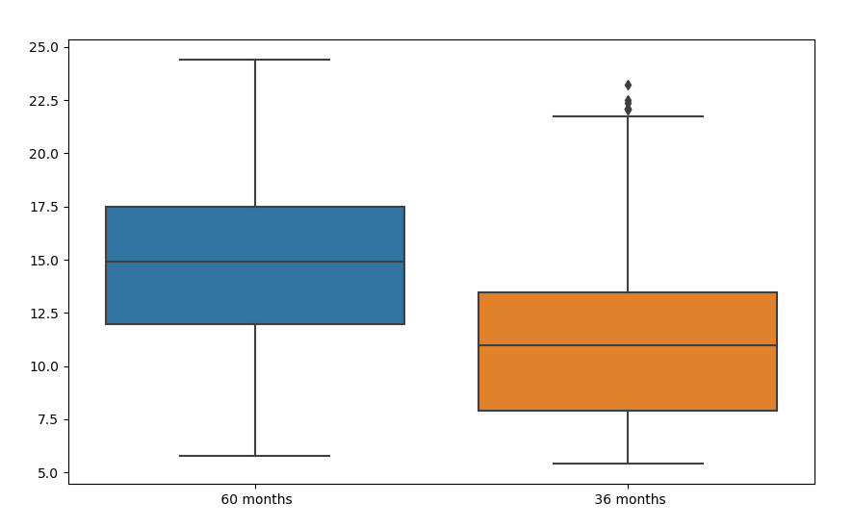
Analysis by term, loan status and interest rate
Summary:
On studying the table displaying the term, we can see that lesser loans defaulted when the term of the loan was 60 instead of 36.
It is clear from box plot that average interest rate is higher for 60 months loan term which implies that the loans issued for longer term had higher interest rates for repayment.
Thus, one of the recommendations here can be that company should provide loans for the longer term to avoid risks.

Slide 7
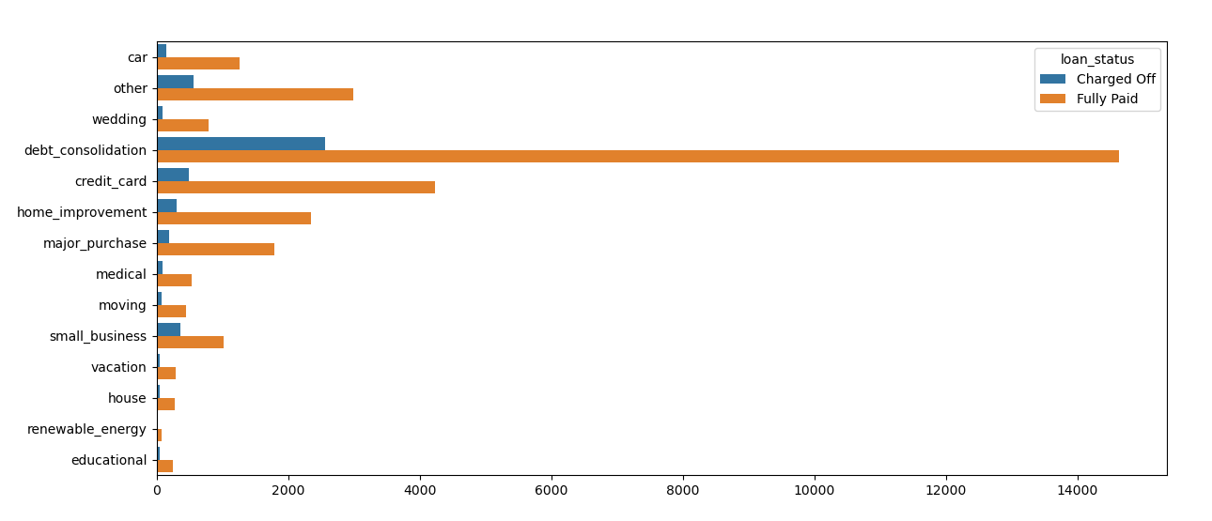
Condition of Loans and Purpose
Summary:
Most frequent Purpose: The reason that clients applied the most for a loan was to consolidate debt.
Less frequent purpose: Clients applied less for educational purposes.

Slide 8
Analysis by State
Summary:
California, New York, Texas and Florida are the states in which the highest amount of loans were issued.
Interesting enough, all four states have a approximate interest rate of close to 13% which is at the same level of the average interest rate for all states (approx. 13%)
California, Texas and New York are all above the average annual income (with the exclusion of Florida), this might give possible indication why most loans are issued in these states.
Idaho, Nebraska and Indiana have high average dti , making them high risk states, whereas Maine, Tennessee and New York have low average dti making them low risk states.
Top 5 states with highest amount of loans issued:
Top 5 states with highest DTI, high risk states:
Top 5 states with low DTI, low risk states:

Slide 9
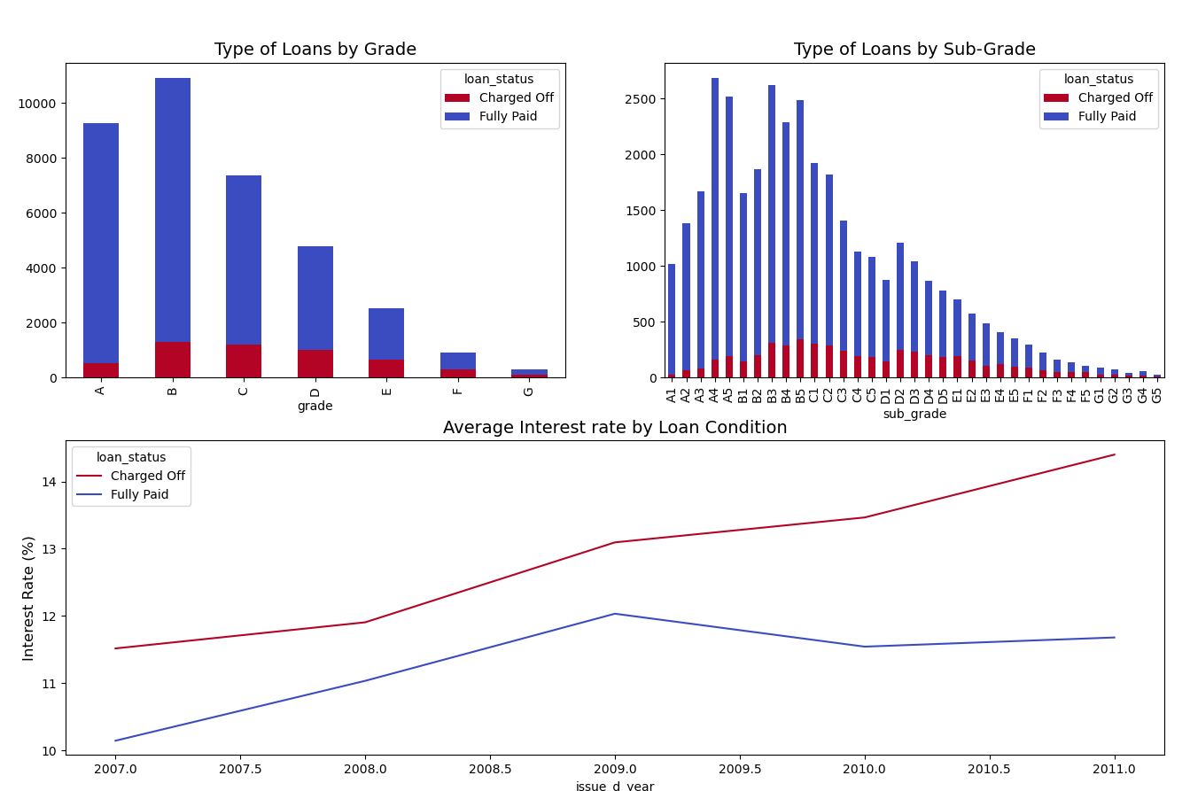
Analysis by Grade and sub-grade
Summary:
Grade “A” and “B” has been most successful in repaying loans.
Referring to the sub-grade view, customers with grade of “C” were more likely to default on loan.
After 2009, the average interest rate on Charged Off loans increased from 13% to more than 14% in 2011.

Slide 10
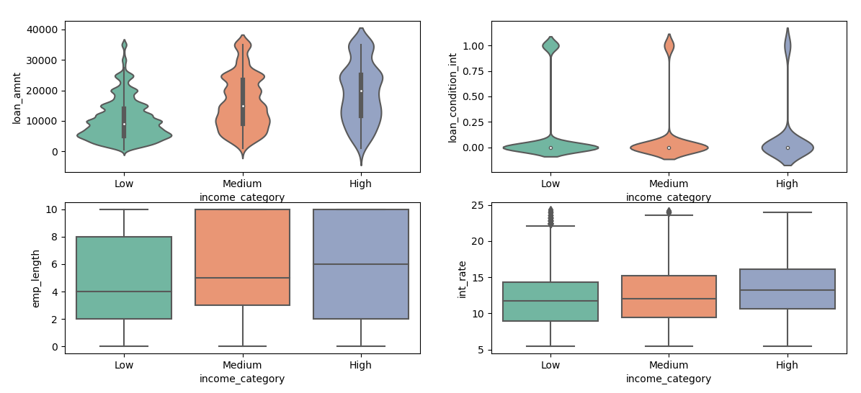
Analysis by Income Category
What we need to know:
Low-income category: Borrowers that have an annual income lower or equal to 100,000 usd.
Medium income category: Borrowers that have an annual income higher than 100,000 usd but lower or equal to 200,000 usd.
High income category: Borrowers that have an annual income higher tha 200,000 usd.
Summary:
Borrowers that made part of the high income category took higher loan amounts than people from low and medium income categories. Of course, people with higher annual incomes are more likely to pay loans with a higher amount. (First row to the left of the subplots)
Loans that were borrowed by the Low income category had a slightly higher change of becoming a bad loan. (First row to the right of the subplots)
Borrowers with High and Medium annual incomes had a longer employment length than people with lower incomes.(Second row to the left of the subplots)
Borrowers with a high income had on average higher interest rates while people with a low annual income had lower interest rates on their loans. (Second row to the right of the subplots)

Slide 11
Conclusions and Recommendations
From the analysis, we can conclude that below variables are driver variables for understanding the loan defaulters and avoiding any risk to business:
Term 2. Income Category 3. State(Addr_state) 4.Grade 5.Purpose
Key Results:
Most of the loans issued were in the range of 5,000 to 15,000 USD.
The 2011 was the year when most loans were issued.
Currently, approx.14% of the loans were charged off thus, various factors discussed further needs to be looked upon to reduce this risk.
Loan by term: Upon analyzing term , it was witnessed that lesser loans defaulted when the term of the loan was 60 instead of 36.
Loan by purpose: The reason that clients applied the most for a loan was to consolidate debt whereas educational purposes seemed out to be the less frequent purpose.
Analysis by state: California, New York, Texas and Florida are the states in which the highest amount of loans were issued.
Analysis by Grade: Grade “A” and “B” has been most successful in repaying loans whereas Grade “C” were more likely to default on loans.
Analysis by Income Category: Borrowers with a high income had on average higher interest rates while people with a low annual income had lower interest rates on their loans.
Recommendations:
Loan by term: One of the recommendations here can be that company should provide loans for the longer term to avoid risks.
Analysis by state:
High risk states: Idaho, Nebraska and Indiana have high average dti , making them high risk states, thus, thorough check needs to be done for providing loan to avoid charged off
Low risk states: Maine, Tennessee and New York have low average dti making them low risk states, thus good for business as Tennessee and New York have high income which reduces the chance of charge off .
Analysis by Grade: As Grade “C” were more likely to default on loans, thorough check is important before approving loan.
Analysis by Income Category:
Low-income group category has less employment length as compared to high- and medium-income group, thus , to reduce chances of charged off , employment length should be checked.
Borrowers with a high income had on average higher interest rates and are more likely to be non- defaulters being less risky and benefit for business.

